Slide 1
Code Breakerz
Jake Bailey, Drew VanAtta, Sadie Borandi

Slide 2
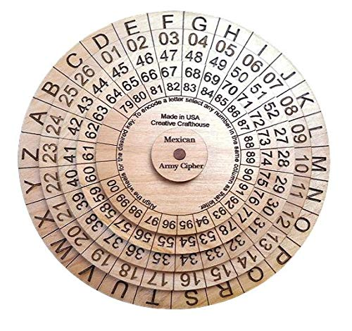
Our Project
We are planning on developing a website that can solve things such as:
Ciphers
Puzzles
Base conversion

Slide 3


Technology stack and tool chain
For our project we are using:
node.js
TypeScript
Express

Slide 4
Individual responsibilities of all members
Our individual responsibilities for this milestone included everyone completing a functioning compilation and running program with our type command. Together we discussed what advancements and improvements we wanted to make to our application. We will all be working equally on achieving our final product design.
Tavier and Sadie will be mainly focused on working to get the proper design and layout for our web app. He will work on the format of the site and will make it user-friendly to use.
Jake and Drew will be heavily focused on hosting the server and will be working with the back end server tasks. This will give us the fundamental important base we need for our site.

Slide 5
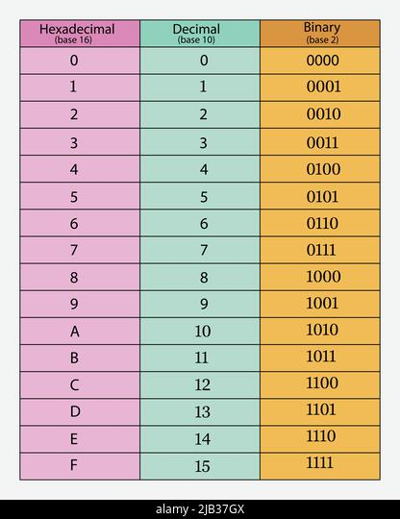
Plan of the next two milestones
In two weeks we plan to at least have the caesar cipher completely implemented and demonstrable
Once completed with the caesar cipher, we plan on expanding our app to include a sudoku solver along with all the number system conversions available such as: binary, decimal, octal and hexadecimal.

Slide 6
A walk-through of the git repo
Main
README.md - File containing team information, compilation instructions, and other documentation
Hellots - folder containing hello world files for typescript
app.ts
index.ts

Slide 7
Team communication plan and workflow, and potential team meetings
We collectively decided the times that work best for us to meet are tuesdays and thursdays after our class session.
We have a group conversation where we can easily reach each other for our plan of communication.
We will be working together as a group and holding each other accountable to construct our final product.

